Slide 1
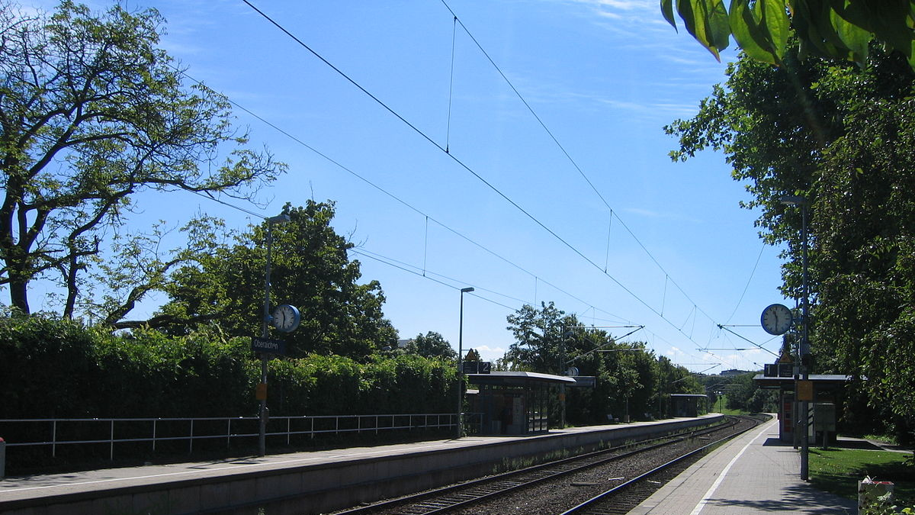

Fantastic Trains (and when to find them)

Slide 2
TEAM
Nils Ayral Data Scientist
Michael Kampmann Data Analyst Consultant
Notes:
Michael

Slide 3

Motivation
In light of the recent international critique on the German public transportation during the European Football Championship, we are keen on improving the situation by analyzing weak points in the DB Infrastructure for optimization prioritization
Notes:
Michael
-International critique increases (European Championship)
-Customer satisfaction on an all time low

Slide 4
Key Questions:
Which german regions show the most indicators for systemic issues?
Where are the systemic issues located within these regions?
Are there hints to the source of the systemic issues?

Slide 5
Stakeholder
Deutsche Bahn and Customers
Notes:
Michael
We are also selfishly interested in improving DB

Slide 6

Visit our Github Repo!
github.com/Nokkyuu/Fantastic_trains_and_when_to_find_them
Notes:
Michael
-ALSO: INTRODUCE OUR 4 PARTS HERE!
-You can visit our GitHub (now or after presentation)
-Link also posted in Chat
https://github.com/Nokkyuu/Fantastic_trains_and_when_to_find_them
-we will show all links in the end again

Slide 7

Part 1:
Data Acquisition
Notes:
Michael
We sperated our work into 3 sections: Data Acquisition, Temporal Analysis and Geographical analysis
We start now with the Data Acquistion

Slide 8
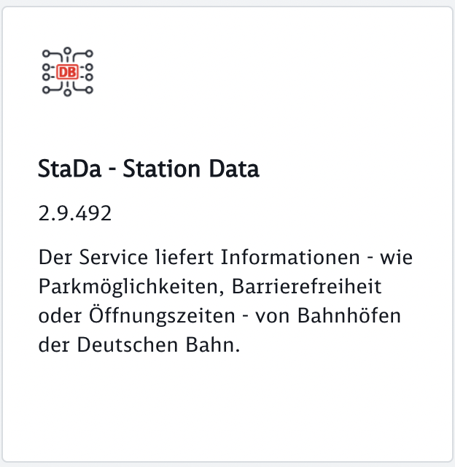

DB API Marketplace
https://developers.deutschebahn.com/db-api-marketplace/apis/product
Timetables:
Planned /Station/Hour:
ID, Arrival, Departure
Path
EVA-Nr
Change /Station/AllKnown
ID, Arrival, Departure
Change Message
StaDa:
Location
EVA-Nr
Category
Notes:
Nils
-We collected our data using the API from the DB API Marketplace
-There are several APIs available (not all for free)
-The 2 Fee APIs we used are the StaDa and the Timetable API
-StaDa: Station Data with EVA-Nr (unique nr for each Station in Germany) as well as data such as Geolocation, Category and much more (toilets, kiosk, vending machines and so on)
-Timetables: can be called for either Planned or for Change data.
- Planned data needs the station nr and a time of day ( 1 Hour interval) -> gives Arrival and departure times, path, ID
- Change data needs station number and gives all known from the moment of the call into the foreseeable future -> gives ID, arrival and departure changes and a change message

Slide 9
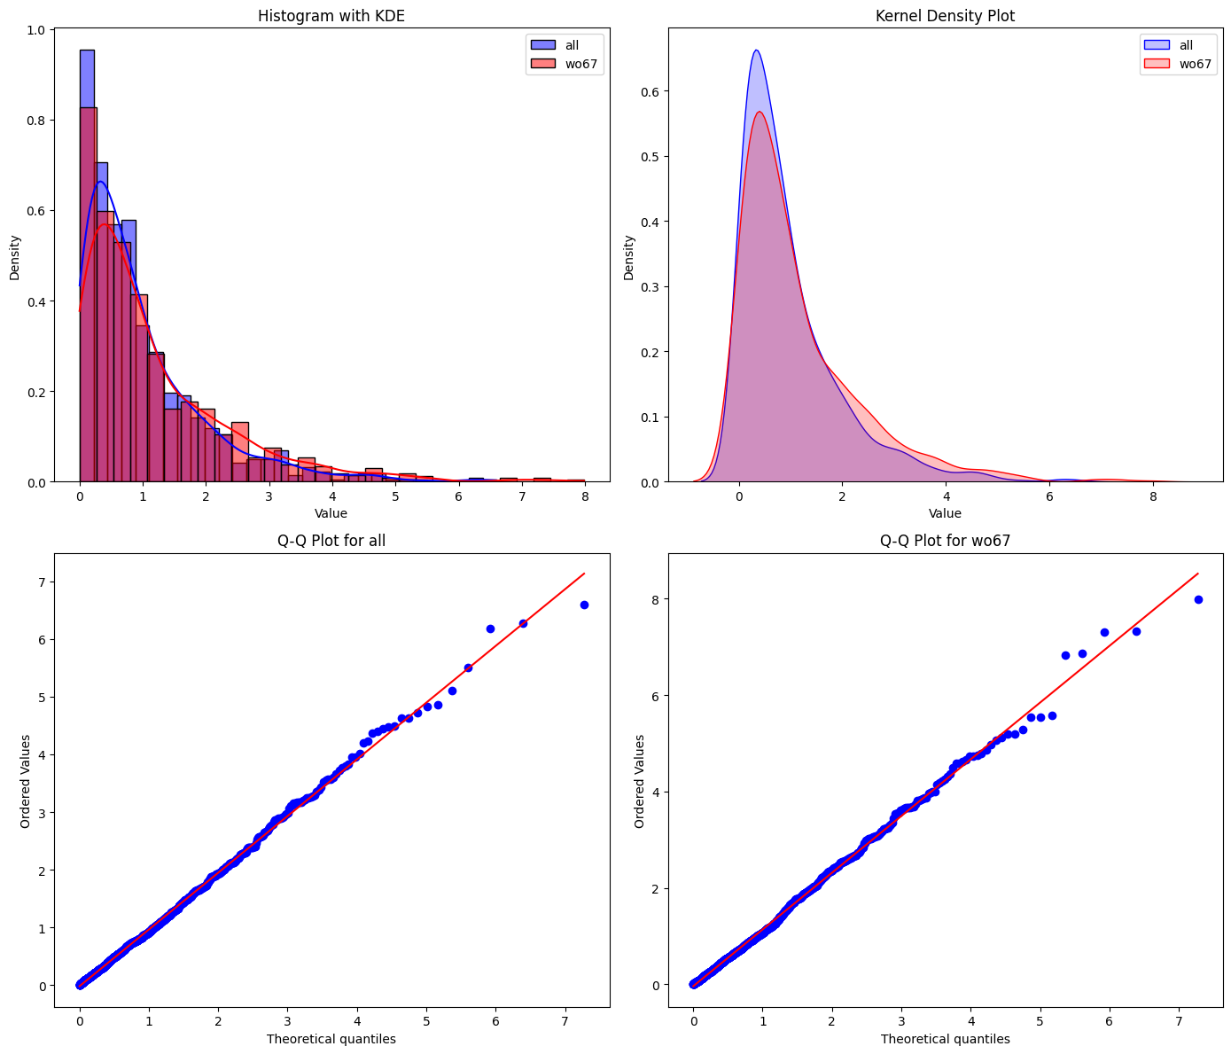
Reducing Volume
3397 of 5398 stations are cat. 6 and 7
Benefits of ignoring those:
Collection script stability
File size
Cleanup effort
Comparison:
Mann-Whitney-U Test p: 0.01
KDE and Q-Q are similar
3397 of 5398 stations are cat. 6 and 7
Benefits of ignoring those:
Collection script stability
File size
Cleanup effort
Comparison:
Mann-Whitney-U Test p: 0.01
KDE and Q-Q are similar
Notes:
Nils
Collecting the data for all Stations from germany is problematic because:
It takes very long (>30 min) making it less of a snapshot (data change within 30 minutes)
A lot of unecessary bloat (3 to 4 times the file size)
More collection time equals more opportunity for problems to occure mid measurement
p value of Mann-Whitney-U Test is below the commonly used 0.05 threshhold
Rejecting the H0 in favor of H1 (the distribution of both groups are not equal)
KDE and Q-Q plots for normalized daza show very similar distributions anyway, with „all data“ having a slight shift to the left.
while there is evidence for a statistical difference, the distributions are similar enough for our purposes (see pictures).

Slide 10
Data Collection
Iterating over all selected stations and combining the dataframes
Wait 1 hour
Collecting arrival and departure plans and changes from Timetable API
Export as CSV
Collecting
StaDa
Combining, sorting, cleaning
Notes:
Nils
- To begin with: 1 time collecting StaDA for EVANr, Geolocation, Category, Name and so
We than collect the arrival and departure data from the timetable API.
First the planned, than the changed, which are in the end joined by the Journey ID.
This is done for every selected Station (the EVANr we choose from the StaDa) (all stations without 6 and 7, roughly 2000 stations)
The data for all stations is concatenated and exported into a CSV
This is done once every hour for several days.
In the end the hourly data is cleaned, sorted and combined into one file

Slide 11
Collected Data
Columns | Description
ID, | Unique Identifier
train, | Name of Train(e.g. RE1)
path, | Previously passed Stations
eva_nr, | Current Stations Number
category, | Station Category (1-6)
station, | Station Name
state, city, zip, | Adress
long, lat, | Coordinates
arrival_plan, departure_plan, | Planned arrival and departure
arrival_change, departure_change, | Most recent change to above
arrival_delay_m,depature_delay_m, | Calculated delay time
arrival_delay_check,departure_delay_check | Delay Category ("delay" or "on_time)
Info | Information message for the change event
1st Set
1.370.589 Rows, 19 Columns From: 23.06. 13:00 To: 27.06. 15:00
2nd Set
976.277 Rows, 20 Columns From: 03.07. 11:00 To: 06.07. 11:00
3rd Set
2063158 Rows, 20 Columns From: 08.07. 00:00 To: 14.07. 23:00
Notes:
Michael

Slide 12
Total Number of Departures
1342120
Total Delay in Minutes
3957865 min
Total Delays
956195
Average Delay Time
1.50 min
Number of Delayed Departures
500805
Number of Delayed Arrivals
455390
Notes:
Michael
~7,5 years of delay in one week
DB definition 6 min not included -> but in the following analyses
Parts ansagen!

Slide 13
Part 2:
Temporal analysis
Notes:
Michael
First we looked into the timely behaviour of delays
To uncover if there are periodic patterns with might suggest systemic issues

Slide 14
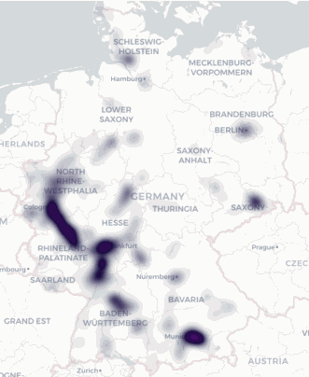

Visit our Dashboard:
Notes:
Michael
-Most of the visuals you will see now can also be seen on our dashboard
-on the right you can see the development of delays over our time period in germany
-you can already see delays multiply and spread out
https://fantastictrainsandwhentofindthem.streamlit.app/

Slide 15
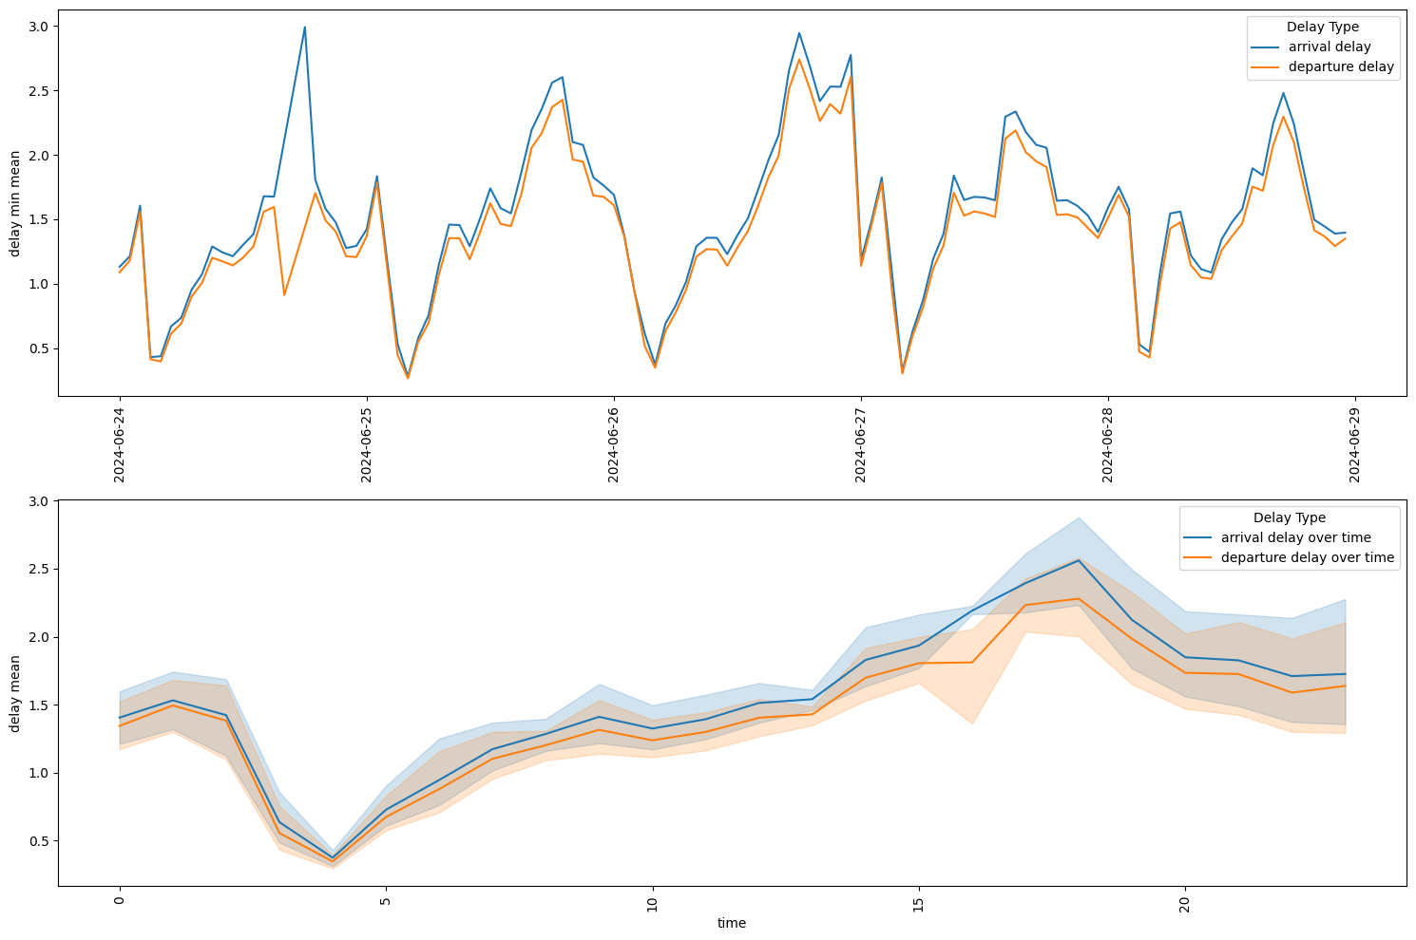
Average delay Germany
Departure/Arrival: insignificant differences
Delay peaks late afternoon
Continuing with departure data
Departure/Arrival: insignificant differences
Delay peaks late afternoon
Continuing with departure data
Notes:
Michael
-the gap on the first day betweeen arrival and departure is due to measurement issues resulting in a gap in the data
- Lowest in the morning and peaks around 4-5 pm

Slide 16
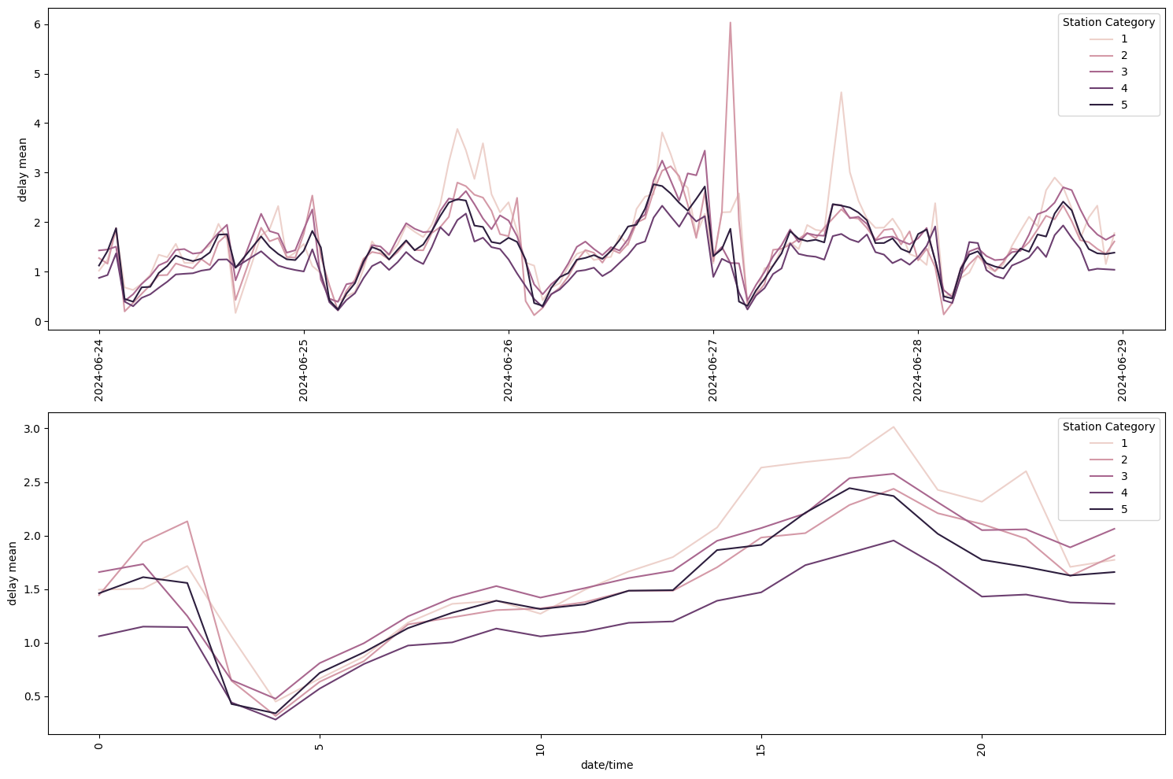
Average delay germany
Higher peaks for bigger stations (lower category)
No significant other differences
Notes:
Michael
-the gap on the first day betweeen arrival and departure is due to measurement issues resulting in a gap in the data

Slide 17
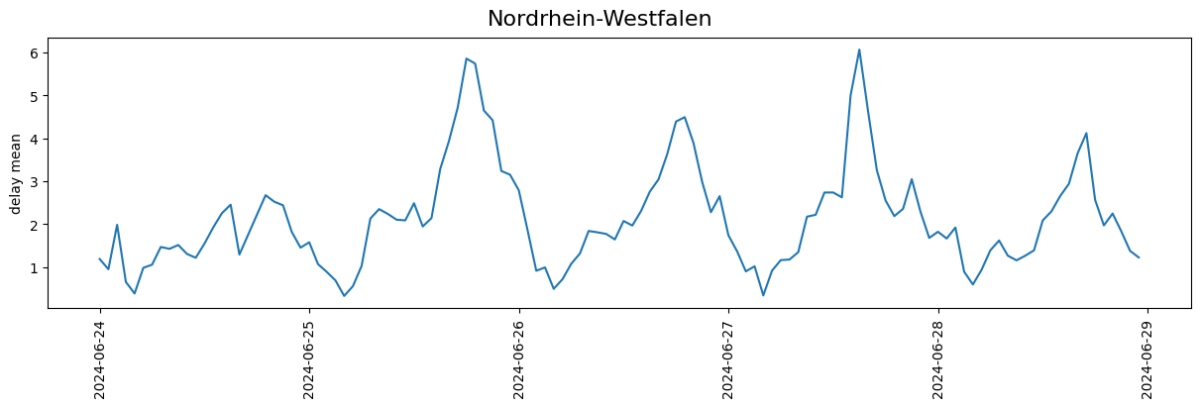
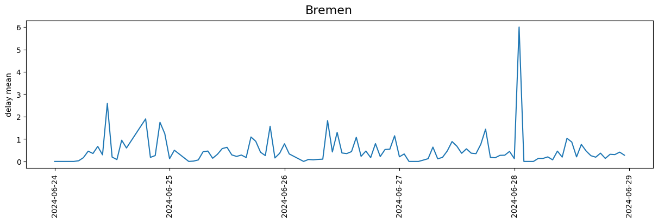
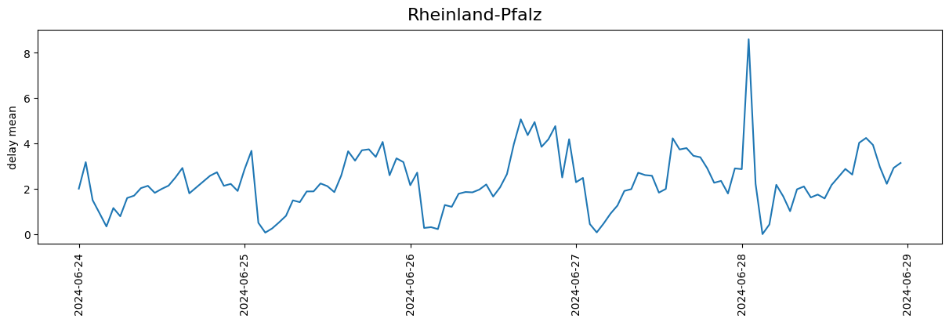
Notes:
Nils
-There are some states which peak everyday around the same time
-some who have seemingly random peaks
-some in between
-we wanted now to quantify how systematic the delay development seems

Slide 18
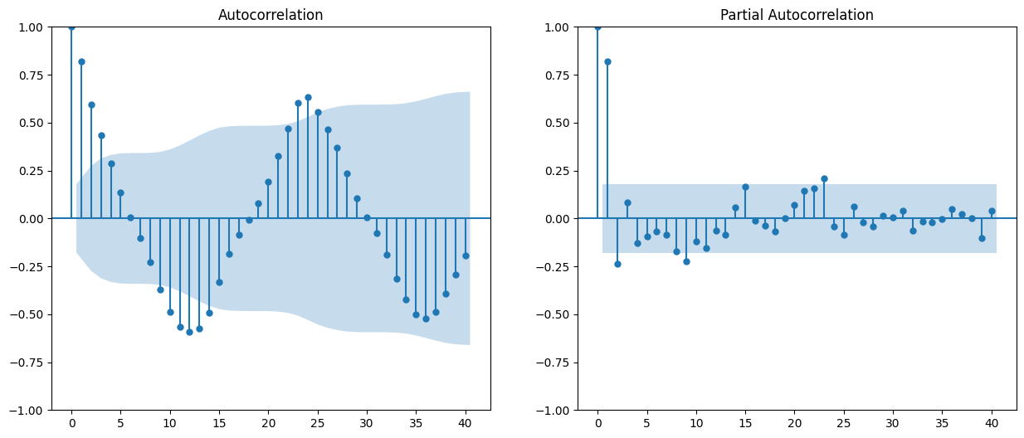
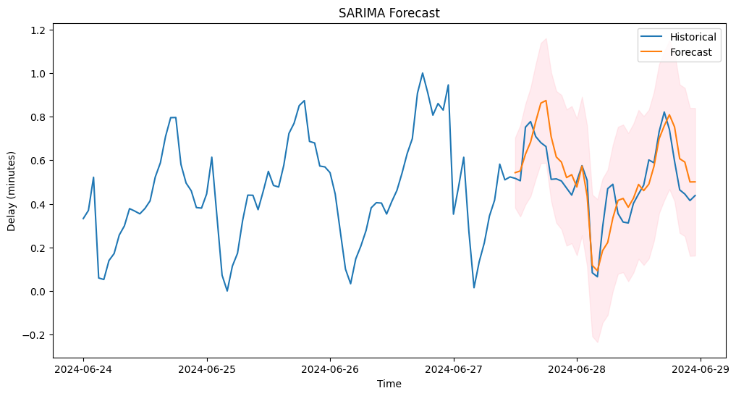
Time Series Analysis
Augmented Dickey-Fuller-Test
p: 8.11e-07
Series is stationary
(Partial) Autocorrelaction
1-3 lags
Best Model:
SARIMA
order=(1, 0, 2)
seasonal_order=(3, 0, 1, 24)
RMSE: 0.10
Predictability: Std/RMSE = 2.0
Notes:
Nils
- Wen did this by means of a time series analysis
Where we postulated that the more accurate the time series can forescast the data in regards to ist standard deviation, the more likely it is to have systemic issues present
For creation the model we need some paramters, first we needed to check if the data is stationary

Slide 19
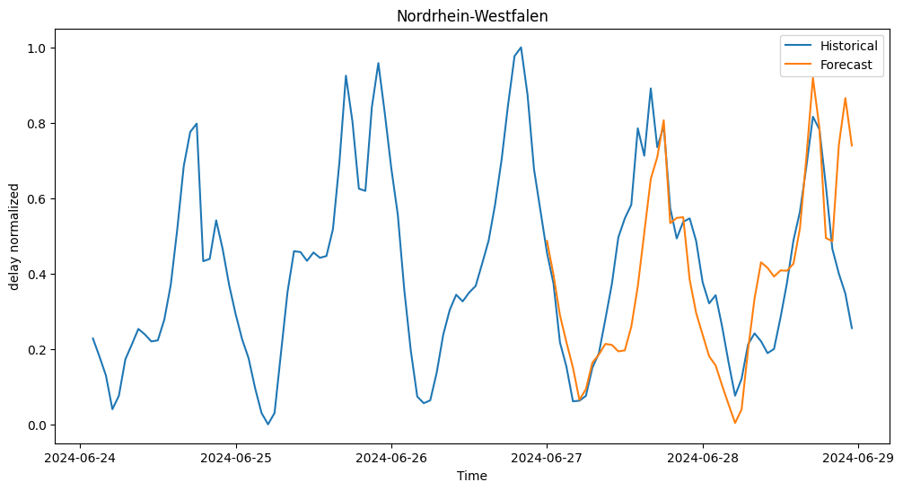
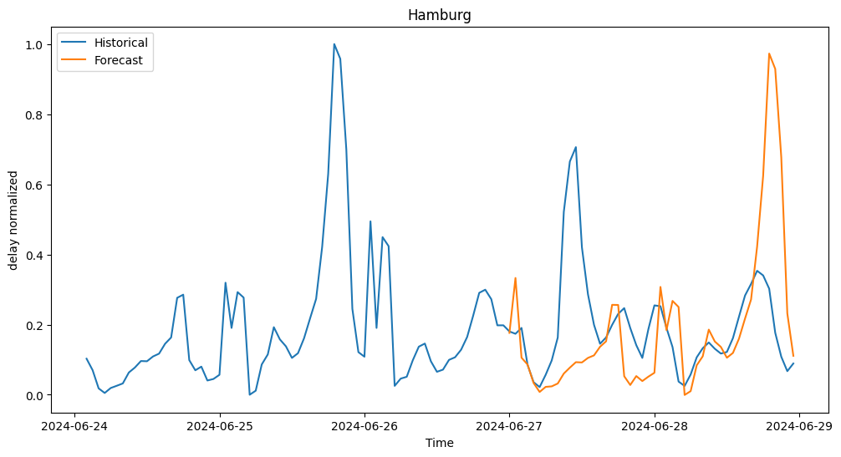
Fit comparison
 | RMSE | STD | pred.
Sachsen-Anhalt | 0,13 | 0,18 | 1,36
Rheinland-Pfalz | 0,15 | 0,20 | 1,33
Hessen | 0,11 | 0,14 | 1,28
Nordrhein-Westfalen | 0,19 | 0,23 | 1,23
Baden-Württemberg | 0,21 | 0,24 | 1,15
Bayern | 0,23 | 0,23 | 1,01
Sachsen | 0,18 | 0,17 | 0,99
Mecklenburg-Vorpommern | 0,18 | 0,16 | 0,88
Schleswig-Holstein | 0,27 | 0,22 | 0,83
Thüringen | 0,31 | 0,25 | 0,80
Saarland | 0,21 | 0,17 | 0,78
Bremen | 0,24 | 0,18 | 0,73
Brandenburg | 0,26 | 0,18 | 0,69
Berlin | 0,30 | 0,20 | 0,67
Niedersachsen | 0,35 | 0,22 | 0,62
Hamburg | 0,24 | 0,15 | 0,60
Same model fitted to 72 h of the data filtered by state
48h forecast
Calculated RMSE and predictability
Higher predictability suggests evidence for systemic issues
Note: all data has been normalized prior
Notes:
Nils

Slide 20
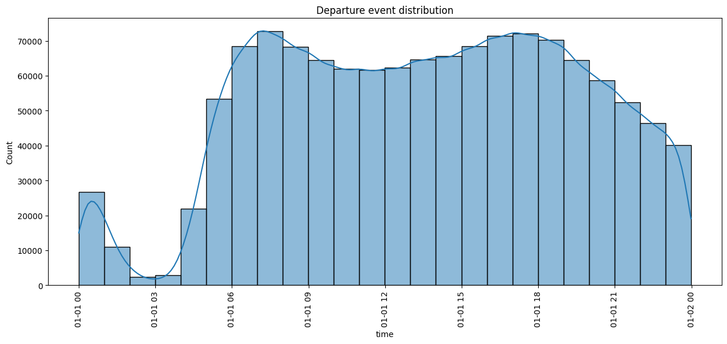
Schedule distribution
More events during rush hour
decreases towards the evening
More events during rush hour
decreases towards the evening
Notes:
Nils

Slide 21
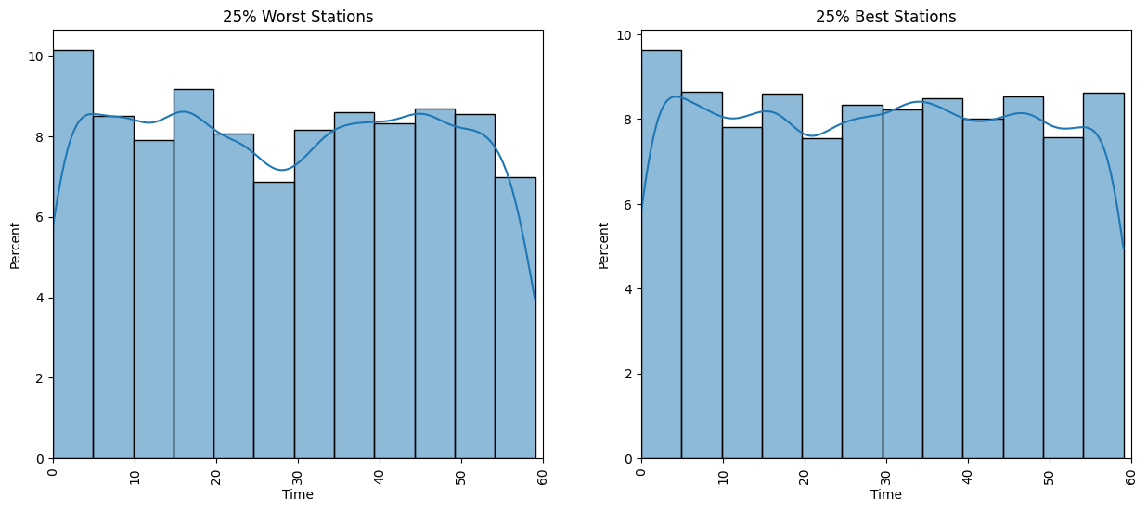
Planned Departures 04:00 PM
Gini Coefficients
Worst: 0.056
Best: 0.024
Notes:
Nils
Conflicts of trains maybe in the worst

Slide 22

Part 3:
Geographical Analysis
Notes:
Nils

Slide 23
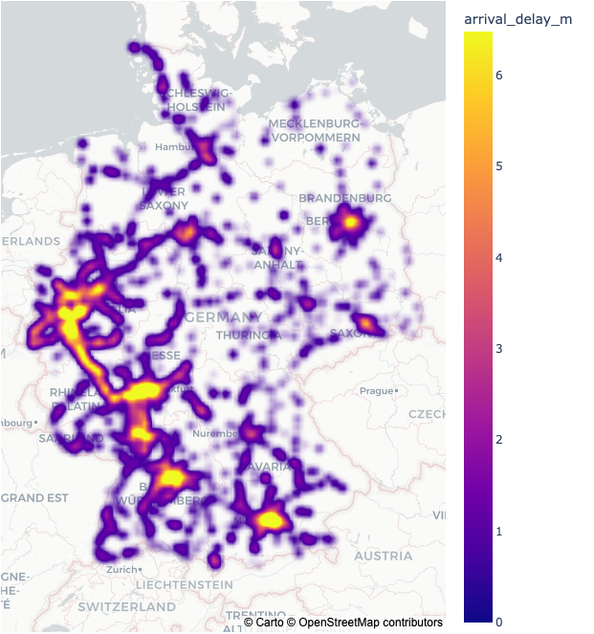
Delay Germany Heatmap
Notes:
Michael
Hotspot Berlin: lot of small delays concentrated on a very small area

Slide 24
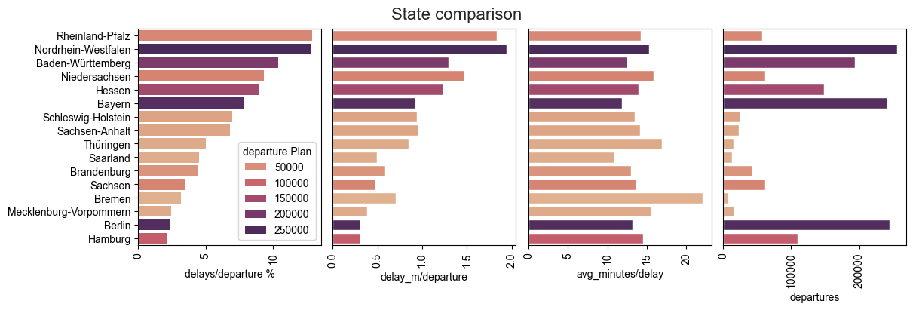
Notes:
Michael
1) about 15% departure have delay in NRW
2) Delay per departure
3) If there is delay, how much is there on average.
4) Departure 5) Decide most important on chart 1 high and chart 4 high

Slide 25
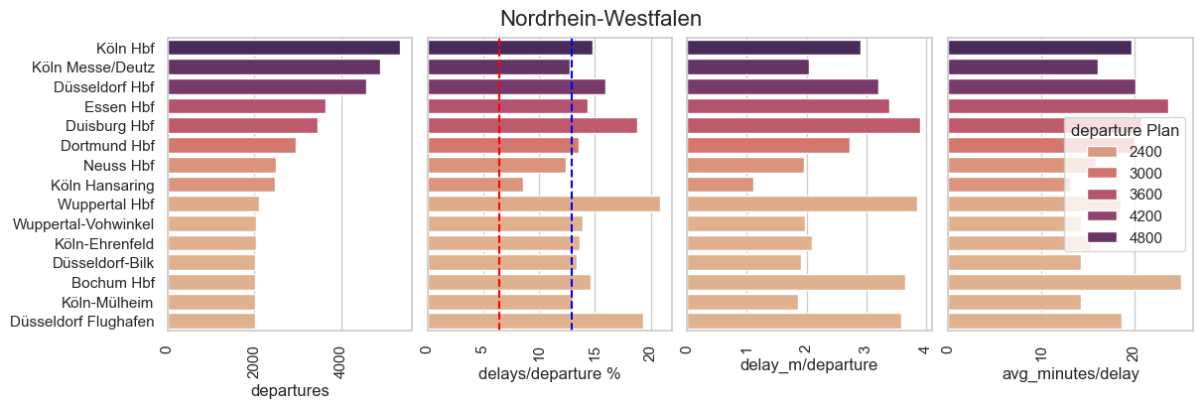
Closer look:
Notes:
Michael
Red line: average germany
Blue line: average state
We will skip the other states for now, you can look at them in on our dashboard

Slide 26
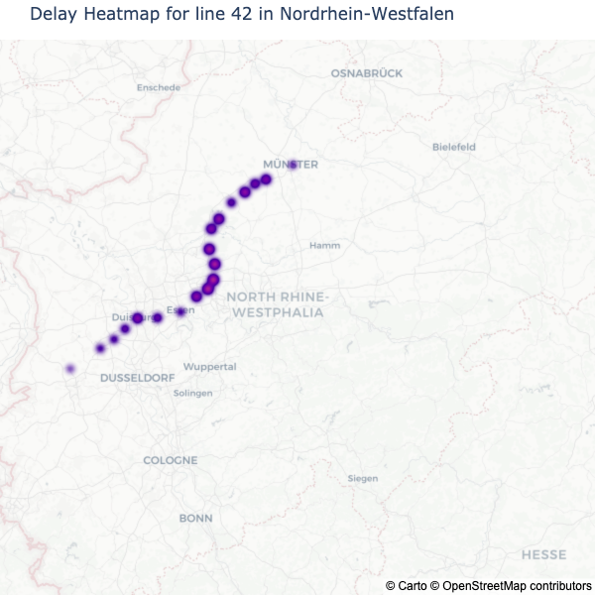
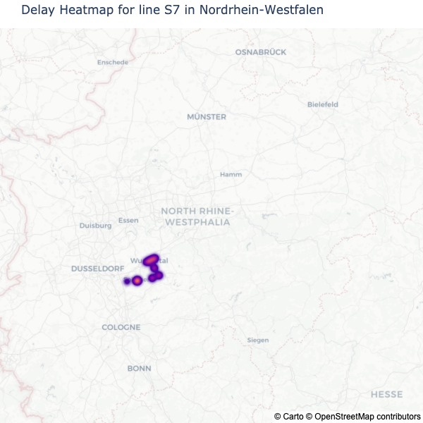
NRW Lines

Slide 27
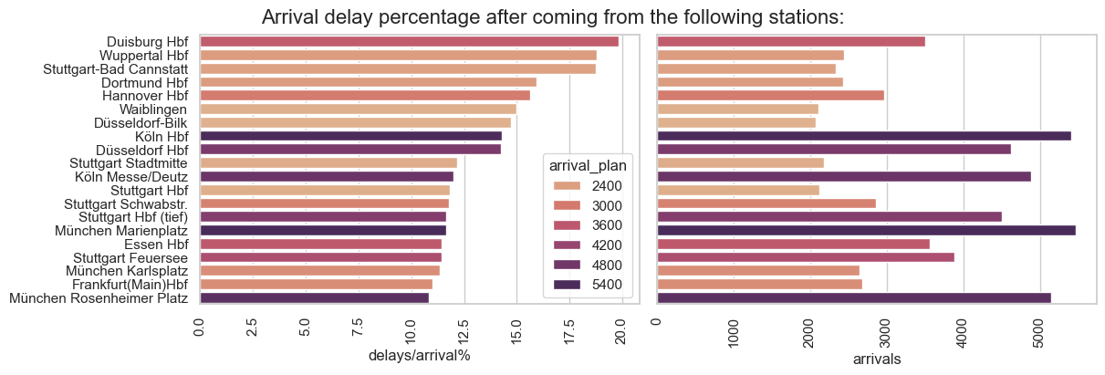
Paths
The path inherits information of all previous stations
Data was cleaned to only show the last station before the current
Notes:
Michael
e.g. Hamburg – Hannover – Hildesheim -> Hildesheim

Slide 28
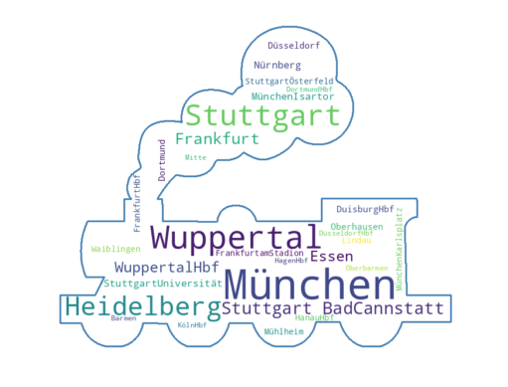
Stuttgart-BadCannstatt | 7 | Waiblingen | 4
WuppertalHbf | 5 | HanauHbf | 4
MünchenIsartor | 5 | MünchenMarienplatz | 4
StuttgartUniversität | 5 | Rüsselsheim | 4
MünchenKarlsplatz | 4 | FrankfurtHbf | 4
DuisburgHbf | 4 | KarlsruheHbf | 3
StuttgartStadtmitte | 4 | Rot-Malsch | 3
OffenbachMarktplatz | 4 | MannheimHbf | 3
Adding the Station, Line and Path analysis together
These Stations occur the most often among the three analysis approaches
Notes:
Michael

Slide 29

Part 4:
Summary and Outlook

Slide 30
Findings
Indicator for systemic issues in several states e.g. NRW, Hessen
Indicator for scheduling issues for stations with frequent delays
Location of bottlenecks within the problematic states: e.g. Wuppertal Hbf, Stuttgart Bad Canstatt
Notes:
Nils

Slide 31
Recommendation & Outlook
Recommendation:
Prioritize the identified geographical hotspots for structural optimization (add redundancy e.g.)
Optimize schedules at hotspots to avoid conflicts
Outlook:
Current Data: Separate and concentrate
Analyse problematic lines along their paths
5 minutes measurement interval
check for increases and reductions of delays between stops
Increase TSA accuracy
Longer and narrower measurement (at least 1 month, 10 min intervals)
Practical use as alert system in addition to analytical use
Gather metadata at hotspots(not included in free API)
# of platforms, switches, geometry etc.
Detailed change messages
Check for distributions for specific issues
Signal disturbances, switch disturbances
Conflict between trains
Notes:
Nils

Slide 32

We are open for job opportunities!
Data published for further use:
Visit our Dashboard:
Visit our GitHub:
fantastictrainsandwhentofindthem.streamlit.app/
github.com/Nokkyuu/Fantastic_trains_and_when_to_find_them
kaggle.com/datasets/nokkyu/deutsche-bahn-db-delays
Notes:
-You can visit our GitHub (now or after presentation)
-Link also posted in Chat
https://fantastictrainsandwhentofindthem.streamlit.app/
https://github.com/Nokkyuu/Fantastic_trains_and_when_to_find_them
https://www.kaggle.com/datasets/nokkyu/deutsche-bahn-db-delays
-we will show all links in the end again

Slide 33
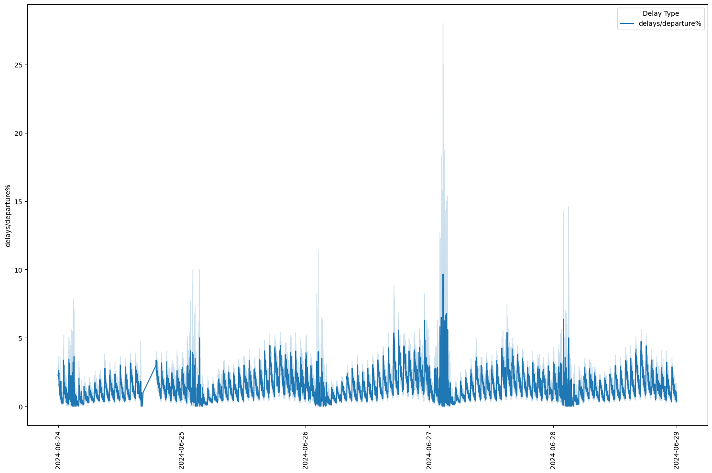
Backup 1

Slide 34
Backup 2
 | RMSE | STD | pred.
Nordrhein-Westfalen | 0,19 | 0,23 | 1,23
Hamburg | 0,24 | 0,15 | 0,60

Slide 35
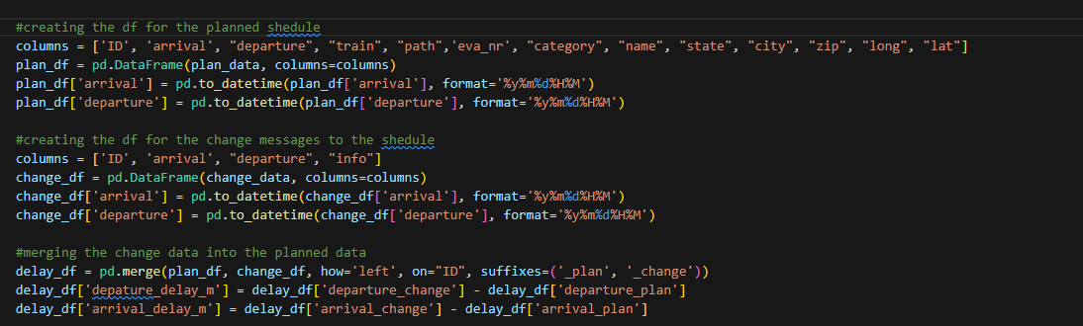
Planned Shedule
08:00 – 08:59
Schedule Changes
8:02 – inf.
All changes that dont belong to the collected shedule are disregarded for the datapoint
Backup 3

